Slide 1

CREATE A BLOG WITH JEKYLL
cOdeland 2018 | by monica powell

Slide 2
FOLLOW ALONG
Create a blog with jekyll
Demo Site:
https://m0nica.github.io/dactl/
GitHub Repository:
https://github.com/M0nica/dactl
Slides:
http://aboutmonica.com/codeland/jekyll.pdf
Notes:
Icebreaker time!

Slide 3
about us!
Create a blog with jekyll
Monica Powell, I’m a long-time #CodeNewbie! I currently lead e-mail marketing at Jopwell and periodically write for FreeCodeCamp, Hacker Noon and Code Like A Girl.
👋🏾 Twitter: @waterproofheart
🔗 www.aboutmonica.com/
Nia Murrell is a self-taught developer and long-time coding enthusiast. She is an active member of the L.A. tech community who volunteers as a developer for small businesses and as a TA for the L.A. chapter of Girl Develop It.
🔗 https://dev.niamurrell.com

Slide 4
ICE BREAKER - WHY ARE YOU HERE?
Create a blog with jekyll
Name
Why do you want to create a technical blog? What are you hoping to gain from having a blog?
Notes:
Icebreaker time!

Slide 5
SOME OF THE TOPICS WE WILL COVER
Create a blog with jekyll
Examples of Jekyll Sites
Static vs. Dynamic Sites
Jekyll Overview
Installing Jekyll
Jekyll Project Structure
Editing Sitewide Variables
Creating a Post
Adding images
Adding Social Icons
Notes:
Some of the topics that will be covered during the workshop today!

Slide 6
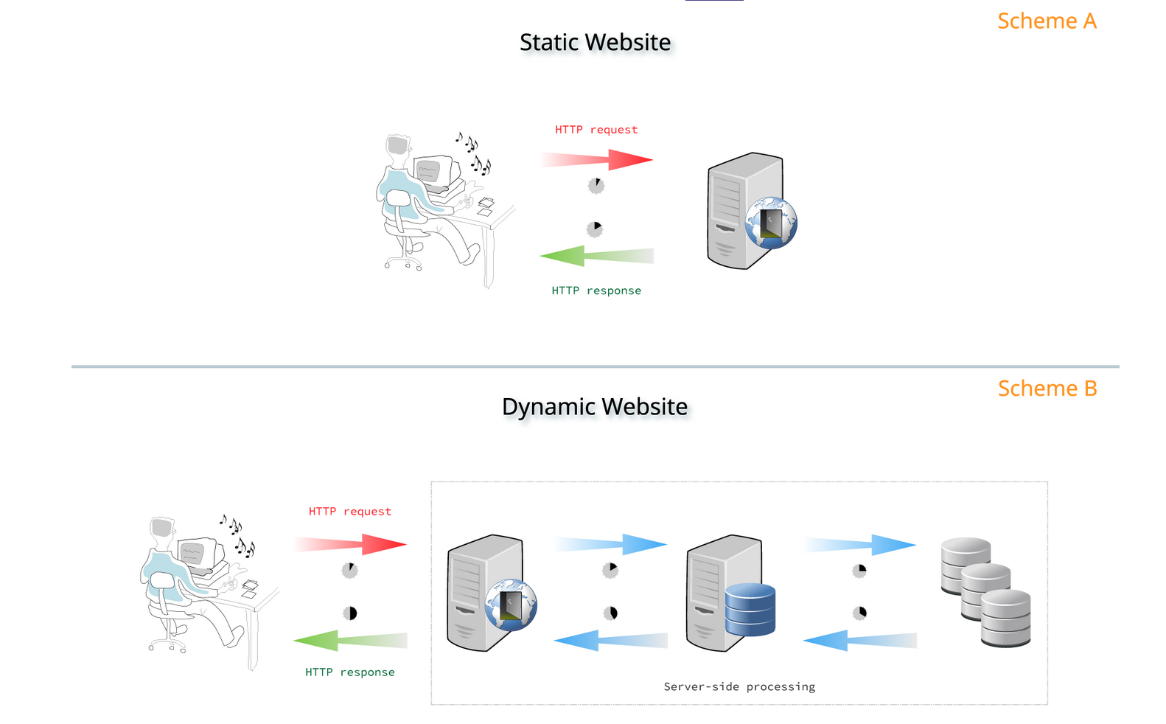
Static vs dynamic websites
Image Source: GitLab
2) STATIC VS DYNAMIC SITES
Notes:
The main difference between static and dynamic websites is that static websites do not have databases or server-side languages. Databases store large amounts of information such as product inventory, purchase history, etc. but are not necessary to create a blog. Source: https://about.gitlab.com/2016/06/03/ssg-overview-gitlab-pages-part-1-dynamic-x-static/
Static websites unlike dynamic websites:
Don’t have databases to maintain or secure
Display the same information for all visitors
Less expensive to host
Load faster
Less prone to hacking

Slide 7
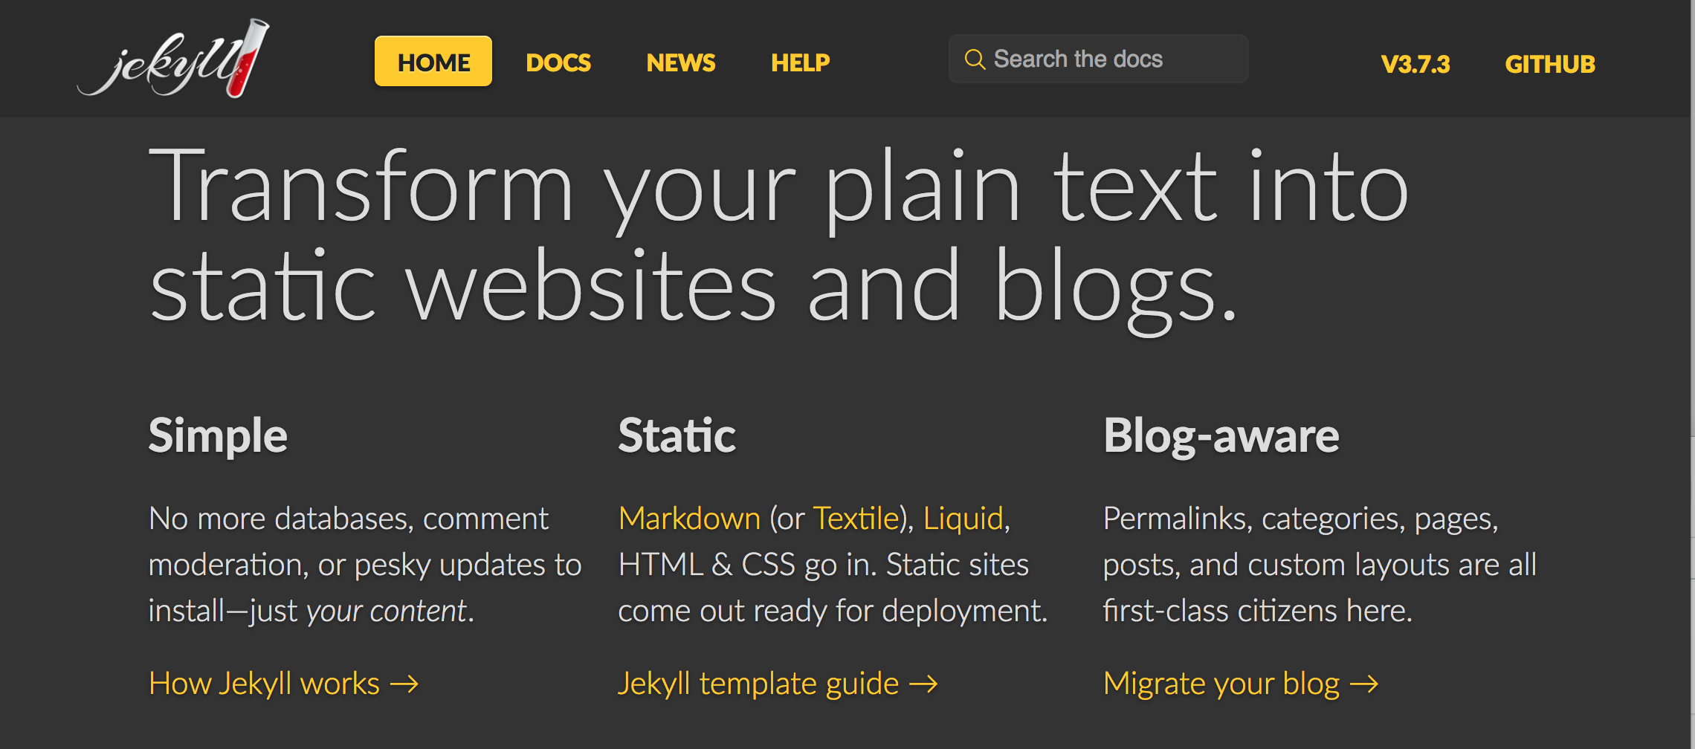
What is jekyll?
3) Jekyll overview
Notes:
- Jekyll is a static site generator that uses Ruby — but you do not have to know Ruby to use Jekyll.
-In other words, Jekyll makes it easy to compile various HTML/CSS and JS files for blogs from plain text a.k.a markdown! That is the magic of Jekyll.
-Once you’re happy with the layout of your site you can just write in “plain text” Markdown

Slide 8
What is jekyll?
3) Jekyll overview
Jekyll is a static site generator. “Blogging is baked into Jekyll’s functionality. If you write articles and publish them online, you can publish and maintain a blog simply by managing a folder of text-files on your computer. Compared to the hassle of configuring and maintaining databases and web-based CMS systems.”
Source: Jekyll Documentation
Notes:
You create your content as text files (Markdown), and organize them into folders. Then, you build the shell of your site using Liquid-enhanced HTML templates. Jekyll automatically stitches the content and templates together, generating a website made entirely of static assets, suitable for uploading to any server.
Read the quote and emphasize that Jekyll is a static site generator a website is not a Jekyll site.
Any questions about Jekyll?

Slide 9
Websites powered by jekyll
1) Examples of jekyll siteS
Documentation Sites
Ruby https://www.ruby-lang.org/en/
Bootstrap https://getbootstrap.com/
Blogs/Personal Websites
https://zachholman.com
www.datalogues.com (Monica’s blog!)
https://www.chenhuijing.com/
Notes:
Here are some examples of websites powered by Jekyll.

Slide 10
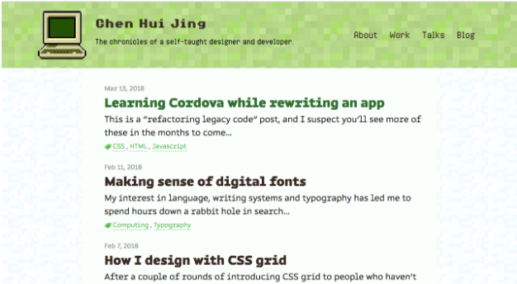
Websites powered by jekyll
1) Examples of jekyll siteS
Ruby documentation https://www.ruby-lang.org/en/
Bootstrap documentation https://getbootstrap.com/
Blog/Personal Website
https://zachholman.com
www.datalogues.com
https://www.chenhuijing.com/#%F0%9F%8E%AE
Notes:
Jekyll makes it easy to create a static blog with a homepage that updates every time you publish a post.

Slide 11
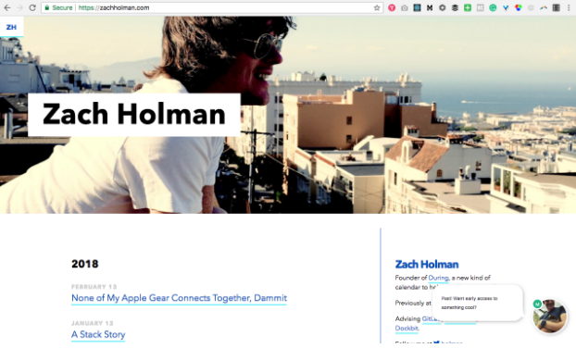
Websites powered by jekyll
1) Examples of jekyll siteS
Ruby documentation https://www.ruby-lang.org/en/
Bootstrap documentation https://getbootstrap.com/
Blog/Personal Website
https://zachholman.com
www.datalogues.com
https://www.chenhuijing.com/#%F0%9F%8E%AE
Notes:
Jekyll can be used to add a log of recent articles to your personal website.

Slide 12

Websites powered by jekyll
1) Examples of jekyll siteS
Ruby documentation https://www.ruby-lang.org/en/
Bootstrap documentation https://getbootstrap.com/
Blog/Personal Website
https://zachholman.com
www.datalogues.com
https://www.chenhuijing.com/#%F0%9F%8E%AE
Notes:
Jekyll blogs can be visually displayed however you want. If you have the CSS to do something then you can likely implement it in Jekyll!

Slide 13
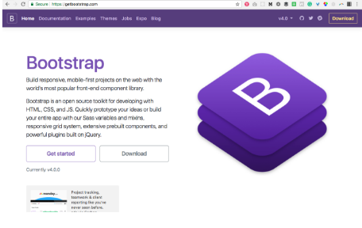
Websites powered by jekyll
1) Examples of jekyll siteS
Ruby documentation https://www.ruby-lang.org/en/
Bootstrap documentation https://getbootstrap.com/
Blog/Personal Website
https://zachholman.com
www.datalogues.com
https://www.chenhuijing.com/#%F0%9F%8E%AE

Slide 14
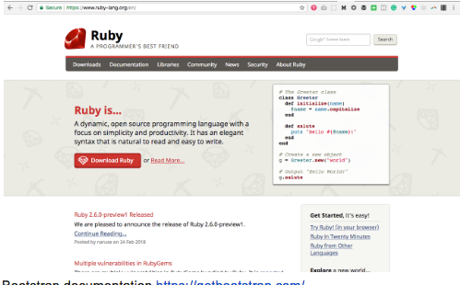
Websites powered by jekyll
1) Examples of jekyll siteS
Ruby documentation https://www.ruby-lang.org/en/
Bootstrap documentation https://getbootstrap.com/
Blog/Personal Website
https://zachholman.com
www.datalogues.com
https://www.chenhuijing.com/#%F0%9F%8E%AE

Slide 15

INSTALLATION FEST
Notes:
Now that know more about Jekyll let’s pair up into groups of 2 and start installing software to run our Jekyll setup.
Recommend pairing up by operating system.

Slide 16
TOOLS WE WILL BE USING TODAY:
4) installing jekyll
Command Line/Terminal
Text Editor
Web Browser
Notes:
Code along -
First open the command line — ask someone if you don’t know where that is.
Then go to the git website to download git — git is a software for version controlling code. A lot of code that is shared open source is shared through services like github that are version control systems but also can function as social networks to share code.
We can confirm install by checking the git version.

Slide 17
Installation fest - INSTALL GIT
4) installing jekyll
Open Command Line
Install git from https://git-scm.com/downloads
Confirm installation by running:
$ git -—version
Notes:
First open the command line — ask someone if you don’t know where that is.
Then go to the git website to download git — git is a software for version controlling code. A lot of code that is shared open source is shared through services like github that are version control systems but also can function as social networks to share code.
We can confirm install by checking the git version.

Slide 18
Installation fest - INSTALL GIT
4) installing jekyll
Configure git with your name and e-mail address.
$ git config --global user.name "John Doe"
$ git config --global user.email johndoe@example.com
Use the same e-mail that is associated with your GitHub account.
Notes:
Next let’s set up git to configure the variables associated with any changes you make….

Slide 19
Installation fest - INSTALL RUBY
4) installing jekyll
Install Ruby
On Windows:
Use RubyInstaller
On Mac:
By default Ruby may be installed depending on OS. If not:
$ brew install ruby
Notes:
Homebrew (OS X)
On macOS (High) Sierra and OS X El Capitan, Ruby 2.0 is included.
Many people on OS X use Homebrew as a package manager. It is really easy to get a newer version of Ruby using Homebrew:
$ brew install ruby
This should install the latest Ruby version.
RubyInstaller
If you are on Windows, there is a great project to help you install Ruby: RubyInstaller. It gives you everything you need to set up a full Ruby development environment on Windows.
Just download it, run it, and you are done!

Slide 20
Installation fest - INSTALL RUBY
4) installing jekyll
Install Ruby and check that version is greater than 2.4.1
Ruby -v
If not install the latest version of Ruby:
rvm install ruby-2.5.1
If wrong version of Ruby is being used:
rvm use —-default 2.5.1
Notes:
During installation rvm might throw warnings about not being in the correct path. I fixed it by running rvm get stable --auto-dotfiles to reset the .bashrc shell scripts, followed by rvm reset. This isn't totally necessary—the `rvm use...` command will work for the current Terminal session, but if people ask how to fix it permanently, this works!
Homebrew (OS X)
On macOS (High) Sierra and OS X El Capitan, Ruby 2.0 is included.
Many people on OS X use Homebrew as a package manager. It is really easy to get a newer version of Ruby using Homebrew:
$ brew install ruby
This should install the latest Ruby version.
RubyInstaller
If you are on Windows, there is a great project to help you install Ruby: RubyInstaller. It gives you everything you need to set up a full Ruby development environment on Windows.
Just download it, run it, and you are done!

Slide 21
Installation fest - INSTALL PROJECT
4) installing jekyll
On GitHub.com fork this repository https://github.com/M0nica/dactl
Notes:
code along to get a copy of the files we will be using for today

Slide 22
Installation fest - INSTALL PROJECT
4) installing jekyll
On command line:
Git clone https://github.com/YOUR_USERNAME/dactl
Note: GitHub may prompt you to login with your credentials.
Notes:
code along to get a copy of the files we will be using for today

Slide 23
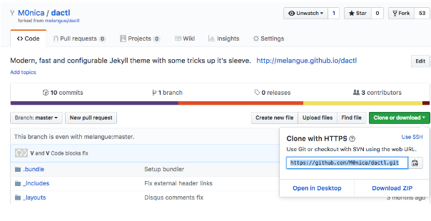
4) installing jekyll
1. Fork my repository at:
https://github.com/M0nica/dactl
On GitHub.com fork this repository https://github.com/M0nica/dactl
On command line:
Git clone https://github.com/YOUR_USERNAME/dactl
Note: GitHub may prompt you to login with your credentials.
2. Navigate to the repository you just forked. Type ‘git clone’ in your terminal followed by this url.
Notes:
code along

Slide 24
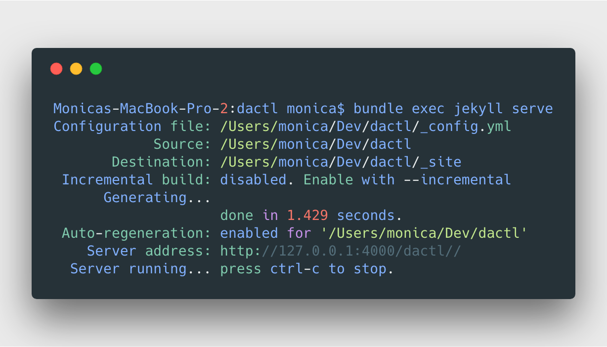
Installation fest - CONFIRM INSTALLATION
4) installing jekyll
Install dependencies and then view Jekyll site with the following commands:
$ gem install bundler
$ cd dactl
$ bundle install
$ bundle exec jekyll serve
Notes:
If wrong version of Ruby is being used:
rvm use —default 2.5.1

Slide 25

Installation fest - CONFIRM INSTALLATION
4) installing jekyll
Visit this website to see local version of the site:
http://127.0.0.1:4000/dactl/
Notes:
Is everyone seeing their website on their local machine? Did anyone have any errors or need a few minutes to catch up?

Slide 26
editing jekyll SITE
Notes:
The first thing we will be learning how to do in Jekyll is how to edit posts.

Slide 27

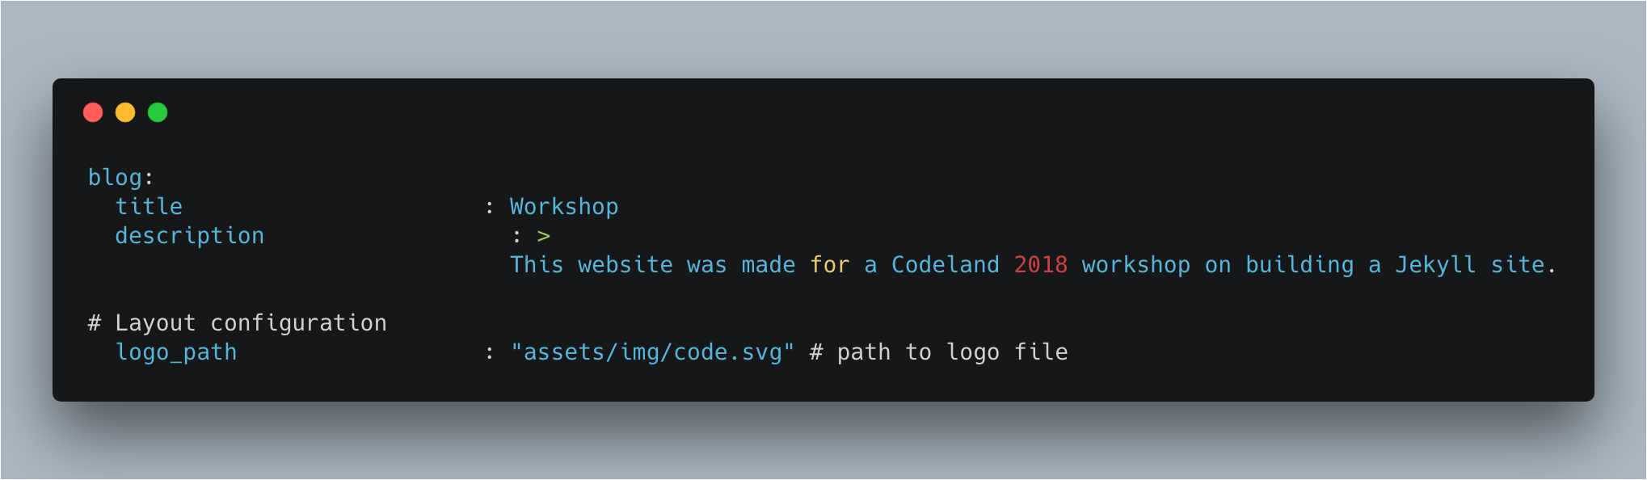
yamL
Create a blog with jekyll
Notes:
Structure variable colon string
_config.yml provides basic settings information about your site, such as the site’s title, logo and how to structure links to posts (e.g. should they follow the pattern MySite.com/year/month/day/post-title?).
First thing to do when creating a blog is to give it a name! let’s do that in the config file.
YAML is used in Jekyll projects to define site-wide variables (in _config.yml) and to tell Jekyll how to process various pages (in front matter of posts).
Front matter is used to tell Jekyll how a Markdown file should be processed. Source: https://jekyllrb.com/docs/frontmatter/
https://github.com/Animosity/CraftIRC/wiki/Complete-idiot%27s-introduction-to-yaml
This file will create a blog post with the post layout titled “YAML front matter in posts”. It will be tagged with jekyll, dactl and howto. It will have a hero image (specified in hero url above) and an orange overlay.
---
layout: post
title: YAML front matter in posts
tags:
- jekyll
- dactl
- howto
hero: https://source.unsplash.com/collection/345758/
overlay: orange
---

Slide 28
yamL _Config.yml
Create a blog with jekyll
Let’s introduce our blog to the world wide web by giving it a title and description!
We will need to edit the _config.yml file to accomplish this.
Notes:
Feel free to edit other parts of the _config_yml.file
ctrl + C (to stop the server if it is running)
bundle exec jekyll serve
Any questions?

Slide 29
yamL _Config.yml
Create a blog with jekyll
Activity: Edit site url, title and description in the _config.YML file.
Hint: server can be reset by typing "ctrl + C” in terminal followed by “bundle exec jekyll serve”.
Notes:
Feel free to edit other parts of the _config_yml.file
ctrl + C (to stop the server if it is running)
bundle exec jekyll serve
Any questions?

Slide 30
yamL _Config.yml
Create a blog with jekyll
Activity: Edit site url, title and description in the _config.YML file.
Edit _config.YML
Restart server
Hint: server can be reset by typing "ctrl + C” in terminal followed by “bundle exec jekyll serve”.
Notes:
Feel free to edit other parts of the _config_yml.file
ctrl + C (to stop the server if it is running)
bundle exec jekyll serve
Any questions?

Slide 31

Write first blog post

Slide 32
WRITE FIRST BLOG POST
Create a blog with jekyll
Jekyll required file name format for blog posts:
YEAR-MONTH-DAY-title.MARKUP
E.g., 2018-05-04-code-land—is-awesome.md
Learn more about excerpts here: https://m0nica.github.io/dactl/posts/post-excerpts-lead-paragraphs
Source: Jekyll Documentation
Notes:
_posts folder holds individual files that each represent a blog post on your website.
ctrl + C (to stop the server if it is running)
bundle exec jekyll serve
Adding a new post to this folder will make a new blog post appear on your website, in reverse chronological order (newest post to oldest).

Slide 33
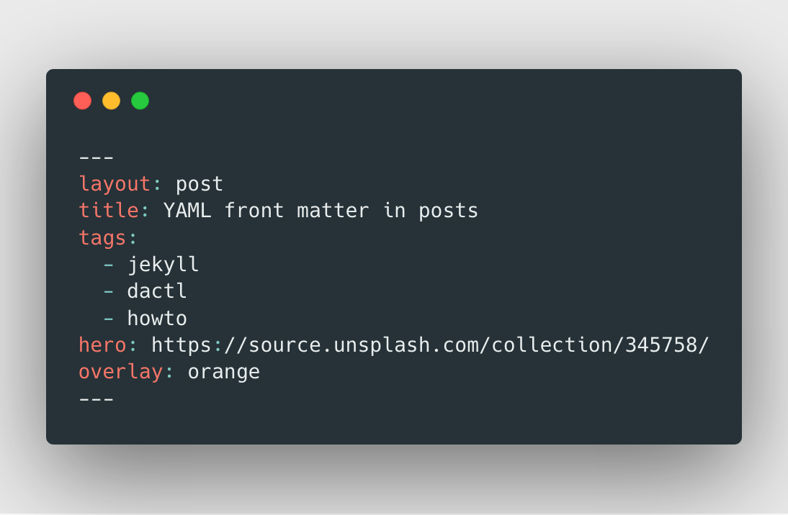
yamL Front Matter
Create a blog with jekyll
View This Post
`cd dactl`
`bundle install`
`jekyll -s`
Notes:
Front matter is used to tell Jekyll how a Markdown file should be processed.
This file will create a blog post with the post layout titled “YAML front matter in posts”. It will be tagged with jekyll, dactl and howto. It will have a hero image (specified in hero url above) and an orange overlay.
---
layout: post
title: YAML front matter in posts
tags:
- jekyll
- dactl
- howto
hero: https://source.unsplash.com/collection/345758/
overlay: orange
---

Slide 34
yamL FRONT MATTER
Create a blog with jekyll
“Any file that contains a YAML* front matter block will be processed by Jekyll as a special file. The front matter must be the first thing in the file and must take the form of valid YAML set between triple-dashed lines.”
(Source: Jekyll Documentation)
Notes:
Front matter is used to tell Jekyll how a Markdown file should be processed. Source: https://jekyllrb.com/docs/frontmatter/
https://github.com/Animosity/CraftIRC/wiki/Complete-idiot%27s-introduction-to-yaml
This file will create a blog post with the post layout titled “YAML front matter in posts”. It will be tagged with jekyll, dactl and howto. It will have a hero image (specified in hero url above) and an orange overlay.
---
layout: post
title: YAML front matter in posts
tags:
- jekyll
- dactl
- howto
hero: https://source.unsplash.com/collection/345758/
overlay: orange
---

Slide 35
yamL front matter
Create a blog with jekyll
Activity: create the front matter for a new post and view it on local server.
Tip: Create a catchy headline to draw readers in!
Notes:
ctrl + C (to stop the server if it is running)
bundle exec jekyll serve

Slide 36
yamL front matter
Create a blog with jekyll
Activity: create the front matter for a new post and view it on local server.
1. Edit front matter
2. Save the file
3. refresh the local version of site
Tip: Create a catchy headline to draw readers in!
Notes:
ctrl + C (to stop the server if it is running)
bundle exec jekyll serve

Slide 37
MARKDOWN REVIEW
Create a blog with jekyll
https://markdown-it.github.io/
Activity: Write a short post in Markdown about something(s) you’ve learned or enjoyed at Codeland so far!
Notes:
Either write your post in Markdown-it and paste it into your file or write Markdown from scratch into our blog post file (under the YAML) ctrl + C (to stop the server if it is running)
bundle exec jekyll serve

Slide 38
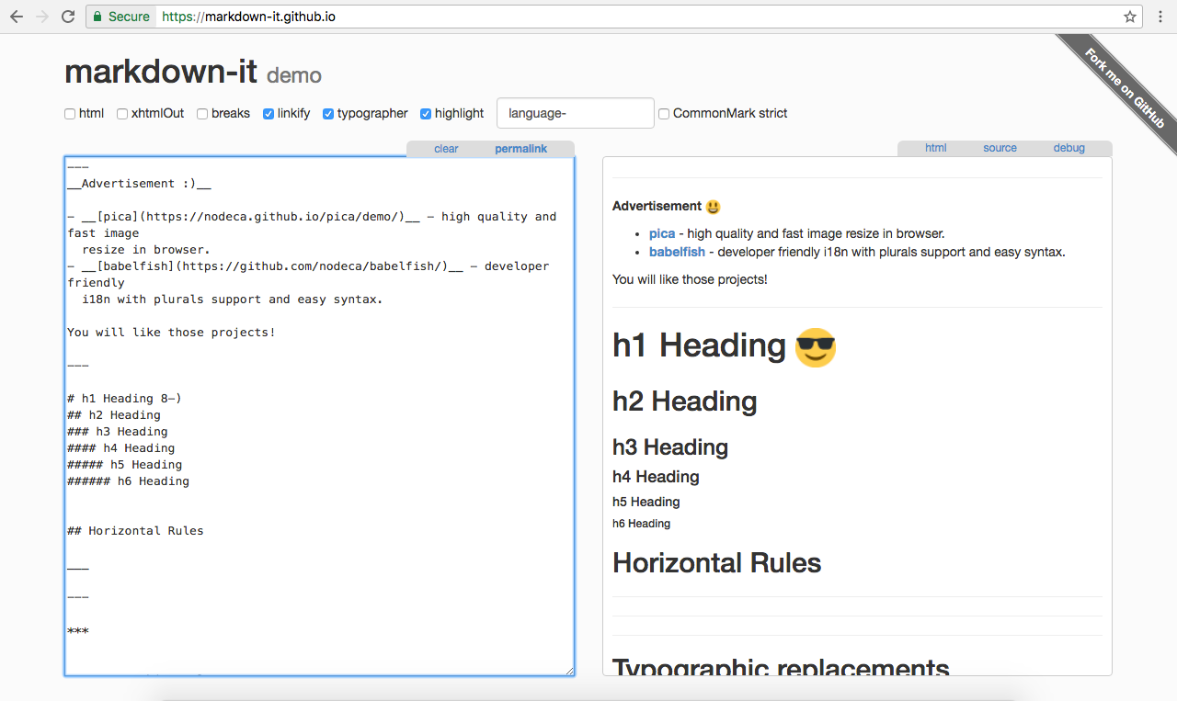
MARKDOWN REVIEW
Create a blog with jekyll
Source: Jekyll Documentation
Notes:
ctrl + C (to stop the server if it is running)
bundle exec jekyll serve

Slide 39
YAML FRONT MATTER
Create a blog with jekyll
Activity edit post:
Change photo overlay in front matter of our post from red to blue, green, purple or orange.
Notes:
ctrl + C (to stop the server if it is running)
bundle exec jekyll serve

Slide 40
PUBLISH CONTENT - GITHUB PAGES
Create a blog with jekyll
Activity: Publish our work on Github!
Commit work to GitHub via the following commands:
git status
git add .
git commit -m "commit message"
git push
Notes:
Do this as a group.

Slide 41

PUBLISH CONTENT - GITHUB PAGES
Create a blog with jekyll
After successfully committing to GitHub, go to your repository’s settings page:
Notes:
Do this as a group.

Slide 42
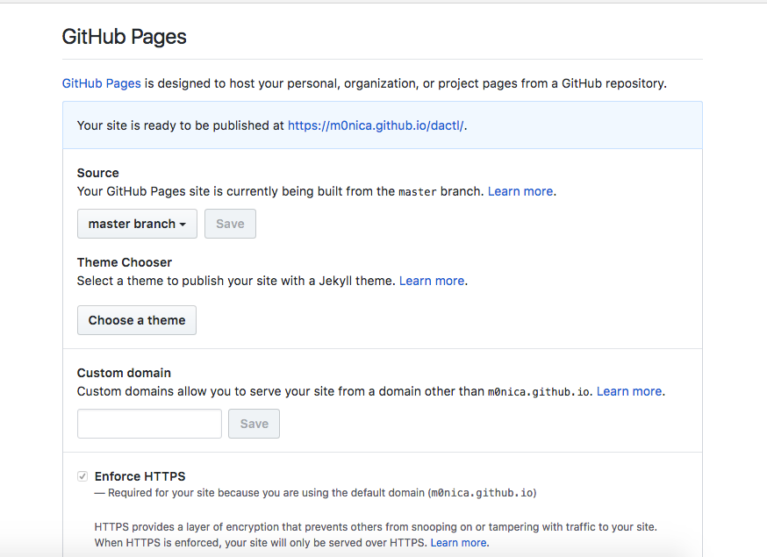
PUBLISH CONTENT - GITHUB PAGES
Create a blog with jekyll
Notes:
Do this as a group!
Scroll down to the GitHub Pages section of settings and select master branch as the source.

Slide 43
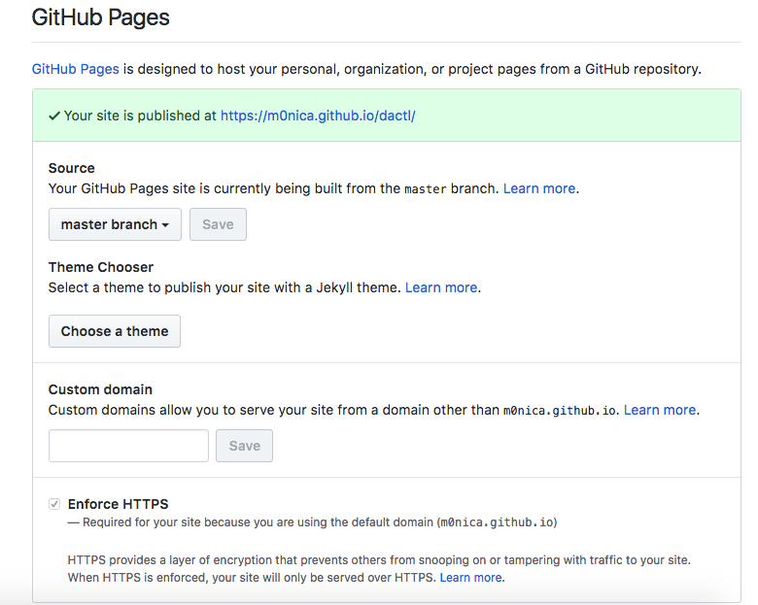
PUBLISH CONTENT - GITHUB PAGES
Create a blog with jekyll
This message should appear after refreshing the page. You can click the link to view your blog on GitHub.
Notes:
Any changes committed made to the master branch will be published.
—include resource to github pages docs
— error messages may appear and should be somewhat helpful

Slide 44
ADDING CONTENT - code blocks
Create a blog with jekyll
Activity: Add a block of code to your blog post
{% highlight ruby %}
def foo
puts 'foo'
end
{% endhighlight %}
Notes:
ctrl + C (to stop the server if it is running)
bundle exec jekyll serve

Slide 45
HIDING CONTENT - DRAFTS
Create a blog with jekyll
Activity: Create a draft blog post
Drafts are posts without date.
Should go in a _drafts folder (in project’s root directory)
Drafts should only appear when you run:
bundle exec jekyll serve —-drafts
Notes:
ctrl + C (to stop the server if it is running)
bundle exec jekyll serve

Slide 46
ADDING CONTENT - about page
Create a blog with jekyll
Activity: Edit About page to better reflect YOU!
Notes:
ctrl + C (to stop the server if it is running)
bundle exec jekyll serve

Slide 47
ADDING CONTENT - about page
Create a blog with jekyll
Activity: Edit About page to better reflect YOU!
Edit About.md
Save file
Refresh browser and see your new about page by clicking on the “About” link in the nav!
Notes:
ctrl + C (to stop the server if it is running)
bundle exec jekyll serve

Slide 48
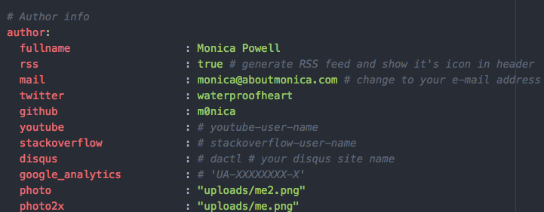

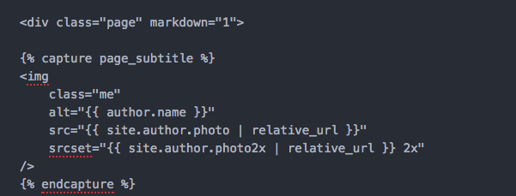
ADDING CONTENT - images
Create a blog with jekyll
Currently our about.md file is using our author photos which are defined in config.yml.
about.md referencing image set in config.yml
Notes:
ctrl + C (to stop the server if it is running)
bundle exec jekyll serve

Slide 49

ADDING CONTENT - images
Create a blog with jekyll
Update author photo by uploading an image of yourself or your favorite animal/character to the uploads folder.
In config file change line 38 and 39 to the name of your file:
38 photo : “uploads/me2.png”
2. Reset Server
Notes:
ctrl + C (to stop the server if it is running)
bundle exec jekyll serve
can either show people how to do it and then have them ask questions or have everyone do it.
upload photo to uploads folder
change reference to image in config
restart server

Slide 50

ADDING PARTIAL - IMAGES
cREATE A BLOG WITH JEKYLL
Pictures are important when blogging. You should never use photos you do not have the rights to use.
Notes:
freeCodeCamp tells potential contributors to “always include a high-resolution image at the top of a story under your headline” as “when people share your story on Facebook and Twitter, it will be more prominent in news feeds, making people more likely to click on it.”
Source: Quincy Larson, How to get published in the freeCodeCamp Medium publication

Slide 51
ADDING PARTIAL - IMAGES
cREATE A BLOG WITH JEKYLL
Below are stock photos that are free for re-use:
https://www.flickr.com/photos/wocintechchat/ (require attribution to #WOCinTech)
https://unsplash.com/
https://www.pexels.com/

Slide 52
ADDING CONTENT - images
Create a blog with jekyll
Find an image!
Add image to assets.
In YAML post hero: reference relative path “/assets/img/filename.jpg”
Notes:
To assign an image on a blog post go to http://www.unsplash.com
ctrl + C (to stop the server if it is running)
bundle exec jekyll serve

Slide 53
ADDING PARTIAL - SOCIAL ICONS
cREATE A BLOG WITH JEKYLL
“Posts with share buttons make content 7 times more shareable than content without them”
Source: Salesforce

Slide 54

ADDING PARTIAL - social icons
Create a blog with jekyll
Partial layouts can be found in the /_includes folder of our project.
Partials = HTML templates with re-usable elements that are found on multiple pages such as as the header, footer, etc.
Activity: Add social icons to all of our posts.
Notes:
ctrl + C (to stop the server if it is running)
bundle exec jekyll serve

Slide 55
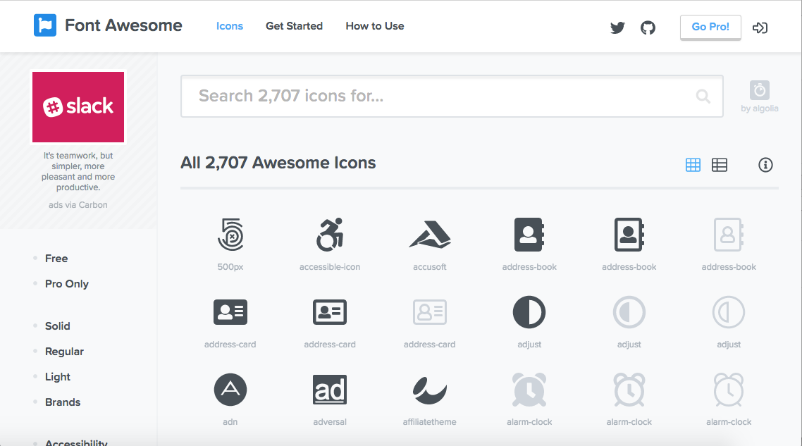
ADDING PARTIAL - social icons
Create a blog with jekyll
We will be using Font Awesome’s free social icons.
FA is referenced in the head of our head.html:
Notes:
ctrl + C (to stop the server if it is running)
bundle exec jekyll serve
<!--- Font Awesome -->
<link rel="stylesheet" href="https://use.fontawesome.com/releases/v5.0.9/css/all.css" integrity="sha384-5SOiIsAziJl6AWe0HWRKTXlfcSHKmYV4RBF18PPJ173Kzn7jzMyFuTtk8JA7QQG1" crossorigin=“anonymous">

Slide 56
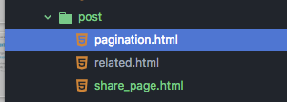
ADDING PARTIAL - social icons
Create a blog with jekyll
Create a file named share_icons.html in the post folder within the _includes folder.
Add a link to the partial file we just created (code below) in our post layout in _layouts/post.html
---
layout: default
---
{% include post.html post=page %}
<!-- The following line links to the partial we created for our social-share-icons -->
{% include post/share_icons.html %}
{% if site.author.disqus %}
{% include externals/disqus.html %}
{% endif %}
{% include post/related.html %}
Notes:
_includes folder has files that get included on all or certain pages (e.g. code to make the header contain your site title and main menu on every page of the site)
_layouts folder contains code that controls how the pages on your site look (default.html), as well as customizations of that code to further style blog posts (post.html) and pages (page.html)
create numbered list within steps
add numbers to each section of the workshop based on which number they on the outline at the beginning.
pause — ask questions throughout!
add more consistent layout b/w the sliders
reduce text on slides — move more towards along.

Slide 57
ADDING PARTIAL - social icons
Create a blog with jekyll
Add HTML for social icons to share_icons.html
<div class="share-page">
<h3>Share "{{ page.title }}":</h3>
<ul class="icons">
<li><a href="https://twitter.com/intent/tweet?text={{ page.title }}&url={{ site.url }}{{ page.url }}&via={{ site.author.twitter }}&related={{ site.author.twitter }}" rel="nofollow" target="_blank" title="Share on Twitter"><i class="fab fa-twitter"></i></a></li>
<li><a href="https://facebook.com/sharer.php?u={{ site.url }}{{ page.url }}" rel="nofollow" target="_blank" title="Share on Facebook"><i class="fab fa-facebook-f">&nbsp;</i></a></li>
<li><a href="https://www.linkedin.com/shareArticle?mini=true&url={{ site.url }}{{ site.baseurl }}{{ page.url }}&title={{ page.title }}&summary={{ page.description }}&source={{ site.title }}"
onclick="window.open(this.href, ‘pop-up’, ‘left=20,top=20,width=500,height=500,toolbar=1,resizable=0’); return false;"
title="Share on LinkedIn"><i class="fab fa-linkedin-in"></i></a></li>
</ul>
</div>
Notes:
ctrl + C (to stop the server if it is running)
bundle exec jekyll serve

Slide 58
ADDING PARTIAL - social icons
Create a blog with jekyll
Add styling for social icons in the _icons.scss file in our _sass folder.
// /* Style all font awesome icons */
.fab {
padding: 20px;
width: 100px;
text-align: center;
text-decoration: none;
color: white;
}
ul.icons {
-webkit-padding-start: 0px;
}
ul.icons li {
display: inline-block;
margin: 10px;
}
Notes:
ctrl + C (to stop the server if it is running)
bundle exec jekyll serve

Slide 59
ADDING PARTIAL - social icons
Create a blog with jekyll
Add background-color for social icons in the _icons.scss file in our _sass folder. According to the brands colors.
// /* Style all font awesome icons */
i.fab.fa-twitter {
background-color: #1da1f2;
}
i.fab.fa-linkedin-in {
background-color: #0077b5;
}
i.fab.fa-facebook-f {
background-color: #3b5998;
}
Notes:
ctrl + C (to stop the server if it is running)
bundle exec jekyll serve

Slide 60
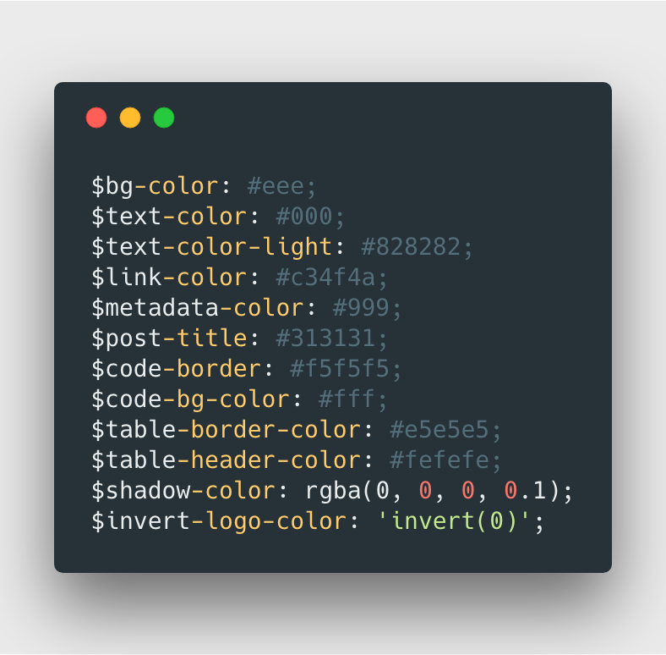
EDIT CSS - UPDATE HEADER COLOR
Create a blog with jekyll
Edit css in _SASS/_variables.scss
Notes:
Raise your hand if you know what sass is
Check-in

Slide 61


EDIT CSS - UPDATE HEADER COLOR
Create a blog with jekyll
Change the hex color in line 24 from $link-color: #8BC34A; to another hex color.
Notes:
ctrl + C (to stop the server if it is running)
bundle exec jekyll serve

Slide 62
EDIT CSS - UPDATE HEADER COLOR
Create a blog with jekyll
Change the hex color in line 24:
$link-color: #8BC34A;
Updated to:
$link-color: #c34f4a;
Feel free to pick your own color!
Notes:
ctrl + C (to stop the server if it is running)
bundle exec jekyll serve

Slide 63
CREATE NEW POST OVERLAY
Create a blog with jekyll
Earlier did you try to change the post overlay color to a color other than red, blue, green, purple or orange?
If so! That shouldn’t have worked. Let’s add a new custom color by navigating to _includes > utils > hero.html
Activity: Create a custom overlay color to better fit your ideal blog aesthetic.
Notes:
ctrl + C (to stop the server if it is running)
bundle exec jekyll serve

Slide 64
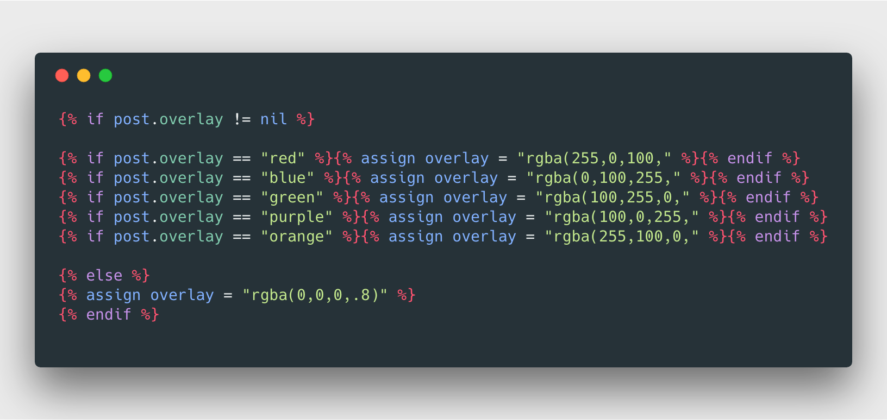
CREATE NEW POST OVERLAY
Create a blog with jekyll
Currently in hero.html only red, blue, green, purple or orange are defined and the fallback is a white color.
Source: Jekyll Documentation
Notes:
ctrl + C (to stop the server if it is running)
bundle exec jekyll serve

Slide 65
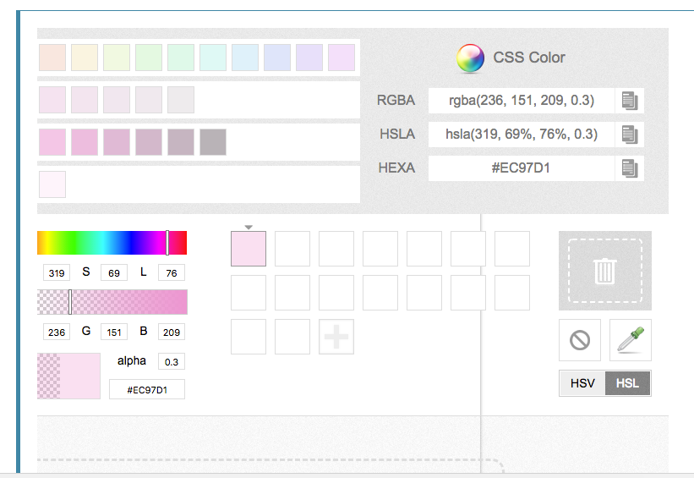
CREATE NEW POST OVERLAY
Create a blog with jekyll
Create bubblegum color
{% if post.overlay == "bubblegum" %}{% assign overlay="rgba(236, 151, 209," %}{%endif %}
{% if post.overlay == “YOUR CUSTOM COLOR" %}{% assign overlay="rgba(R, G, B," %}{%endif %}
Choose your own color at: https://developer.mozilla.org/en-US/docs/Web/CSS/CSS_Colors/Color_picker_tool
Notes:
ctrl + C (to stop the server if it is running)
bundle exec jekyll serve

Slide 66

CREATE NEW POST OVERLAY
Create a blog with jekyll
Change front matter:
overlay: bubblegum
Refresh blog and see new bubble gum colored post!
Notes:
ctrl + C (to stop the server if it is running)
bundle exec jekyll serve

Slide 67
CODING FREESTYLE
Create a blog with jekyll
Delete stock posts
Change color scheme
Add a new posts or pages
Upload new site icon!
Customize 404 Page
Update variables in config.yml
Notes:
ctrl + C (to stop the server if it is running)
bundle exec jekyll serve

Slide 68
Show and tell
show everyone what your blog looks like
Notes:
End on a discussion!
what are you excited about? what was hard? what was new? Will you use Jekyll in the future?

Slide 69
NEXT STEPS
CREATE A BLOG WITH JEKYLL
Resources/Ideas of things to do with Jekyll
https://jekyllrb.com/docs/resources/
Read about how to get published in the largest technical publication on Medium: https://medium.freecodecamp.org/how-to-get-published-in-the-freecodecamp-medium-publication-9b342a22400e
Check out other static site generators:
Gatsby (React-based)
Hugo (Go-based)
Notes:
— show examples of more complex things that can be accomplished in Jekyll! (reference examples from earlier)
— resources on what to try next!

Slide 70
🎉 THANK YOU!
qUESTIONS?
Feel free to e-mail me at: Monica@AboutMonica.com

